Slide 1
Using TestSafe data to support quality improvement Modified DCIP learning session
Dr. Wing Cheuk Chan
Public Health Physician, Population Health Team, Strategic Development
Counties Manukau District Health Board
Email: wingcheuk.chan@cmdhb.org.nz
Date: July 2016
Created by: Wing Cheuk Chan

Slide 2
Overview of presentation
Brief introduction about TestSafe and related publications
Population level analyses to provide context
Practice level analyses to be discussed as part of the learning session

Slide 3
TestSafe
The lab results that you see in web éclair / GP Concerto
TestSafe is a regional lab results repository
Contains all community and hospital lab test results in Auckland region in New Zealand since July 2006, not only the ones requested or carbon copy to the practice.
Prior to July 2006, only hospital test results and community results that were sent to secondary care clinicians were recorded in the data repository
Notes:
Some lab results dated all the way back to 1993

Slide 4
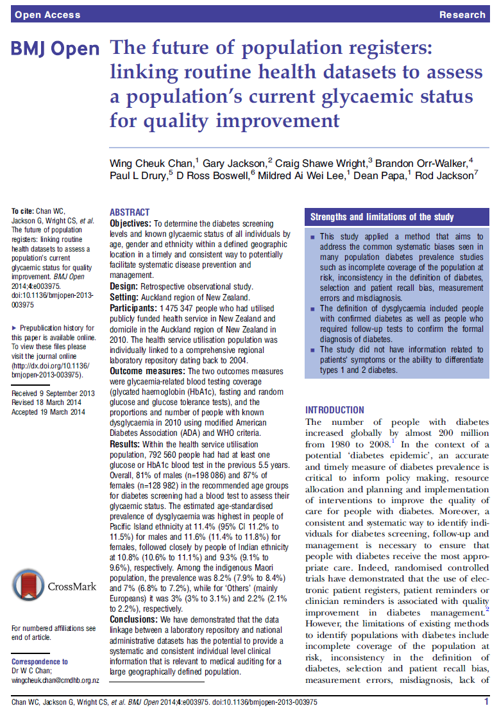
Results previously published
Chan WC, Jackson G, Wright CS, et al. BMJ Open 2014;4:e003975. doi:10.1136/bmjopen-2013-003975
Major updates with significant methodological improvements are in progress using 2015 data
Notes:
Worth reading the discussion section… the potential value, and why it is important.

Slide 5
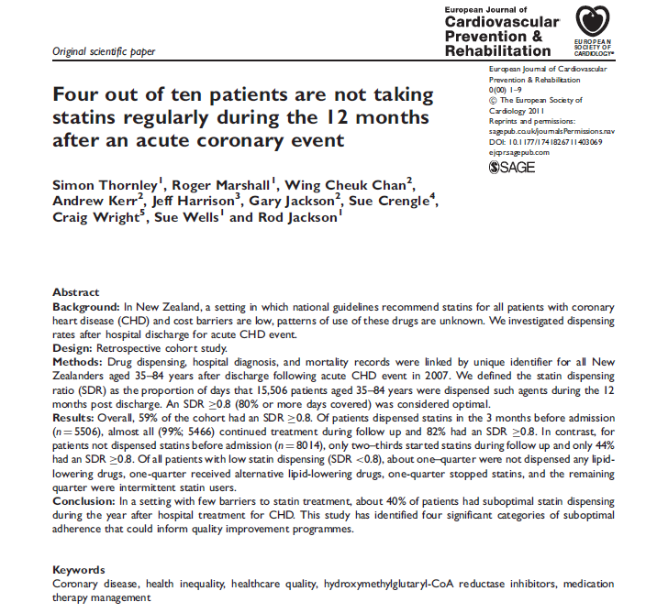
Linking clinical indications to pharmaceutical dispensing data from MOH

Slide 6
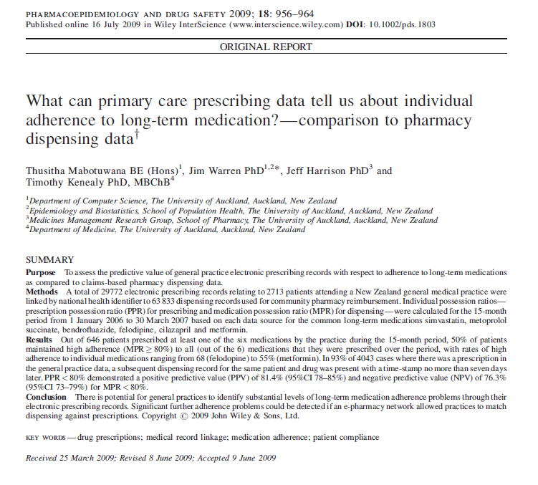
Prescribing and dispensing is highly correlated
South Auckland study found 93% of the long term condition meds were subsequently dispensed within 7 days.

Slide 7
Diabetes related testing coverage is high in 2014 (Auckland metro, PHO enrolled population)
Age | Number of enrolled population |  | % of people who had 2 or more fasting glucose, HbA1c and/or GTT, tests in Auckland region only |  | % of people who had at least one test in any of 4 test category
 | Female | Male | Female | Male | Female | Male
0-24 | 256,844 | 261,107 | 6% | 3% | 33% | 31%
25-29 | 55,508 | 47,409 | 30% | 16% | 73% | 60%
30-34 | 57,108 | 47,848 | 41% | 24% | 79% | 64%
35-39 | 52,953 | 45,589 | 49% | 38% | 83% | 74%
40-44 | 56,756 | 49,813 | 57% | 51% | 87% | 83%
45-49 | 55,303 | 50,790 | 66% | 65% | 91% | 90%
50-54 | 52,925 | 49,642 | 75% | 75% | 94% | 94%
55-59 | 44,746 | 42,104 | 82% | 82% | 96% | 96%
60-64 | 37,768 | 35,630 | 86% | 88% | 97% | 97%
65-69 | 31,705 | 30,413 | 90% | 91% | 98% | 98%
70-74 | 23,000 | 21,221 | 92% | 93% | 98% | 98%
75-79 | 16,904 | 14,659 | 93% | 94% | 98% | 98%
80-84 | 11,951 | 9,427 | 93% | 93% | 99% | 99%
85+ | 13,406 | 7,448 | 88% | 91% | 99% | 99%
Overall | 766,877 | 713,100 | 45% | 40% | 70% | 65%
Diabetes testing coverage is high among people eligible for CVD risk assessment

Slide 8
Definition of diabetes as per NZSSD guidelines
Because actual test results are available in TestSafe
Criteria:
2x Fasting glucose ≥ 7.0 mmol/L on different days
2x HbA1c≥ 50 mmol/mol (6.7%) on different days (Note: International definition HbA1c≥ 47.5 mmol/mol (6.5%)
2x Random glucose ≥ 11.1 mmol/L on different days
1x Glucose Tolerance test >= 11.1 mmol/L
Or any of the combo:
1x HbA1c≥ 50 mmol/mol +1x Fasting glucose ≥ 7.0 mmol/L on different days
1x HbA1c≥ 50 mmol/mol +1x random glucose ≥ 11.1 mmol/L on different days
1x Fasting glucose ≥ 7.0 mmol/L + 1x Random glucose ≥ 11.1 mmol/L diabetes on different days
Notes:
Included the combo tests on different days
Used one GTT only instead of 2 positive GTT, as not many had 2 lots of positive GTT in the real world.

Slide 9
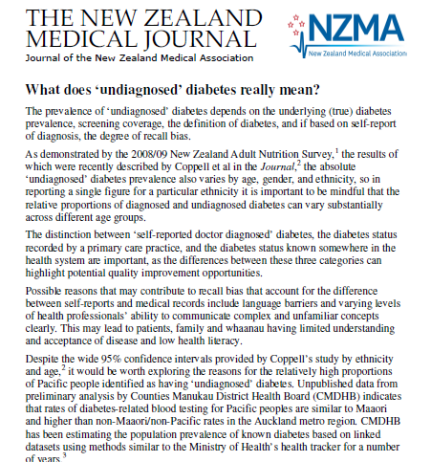
Undiagnosed “diabetes”
Historical claims of the proportion of diabetes that is undiagnosed are no longer valid given the high testing coverage.
Emphasis needs to be on improving management not just about screening
Notes:
e.g. Coppell’s study in 2013, NZMJ 126:1370

Slide 10
diabetes prevalence

Slide 11
‘Diabetes’ prevalence, by ethnicity

Slide 12
Diabetes prevalence, by age and ethnicity

Slide 13
‘Diabetes’ prevalence, by NZ deprivation index
Gradient highlights importance of environmental drivers
Notes:
Implications for inter-sector work..
2.3% vs 8.9%
CMDHB:
36% in NZdep 9 and 10 deciles

Slide 14
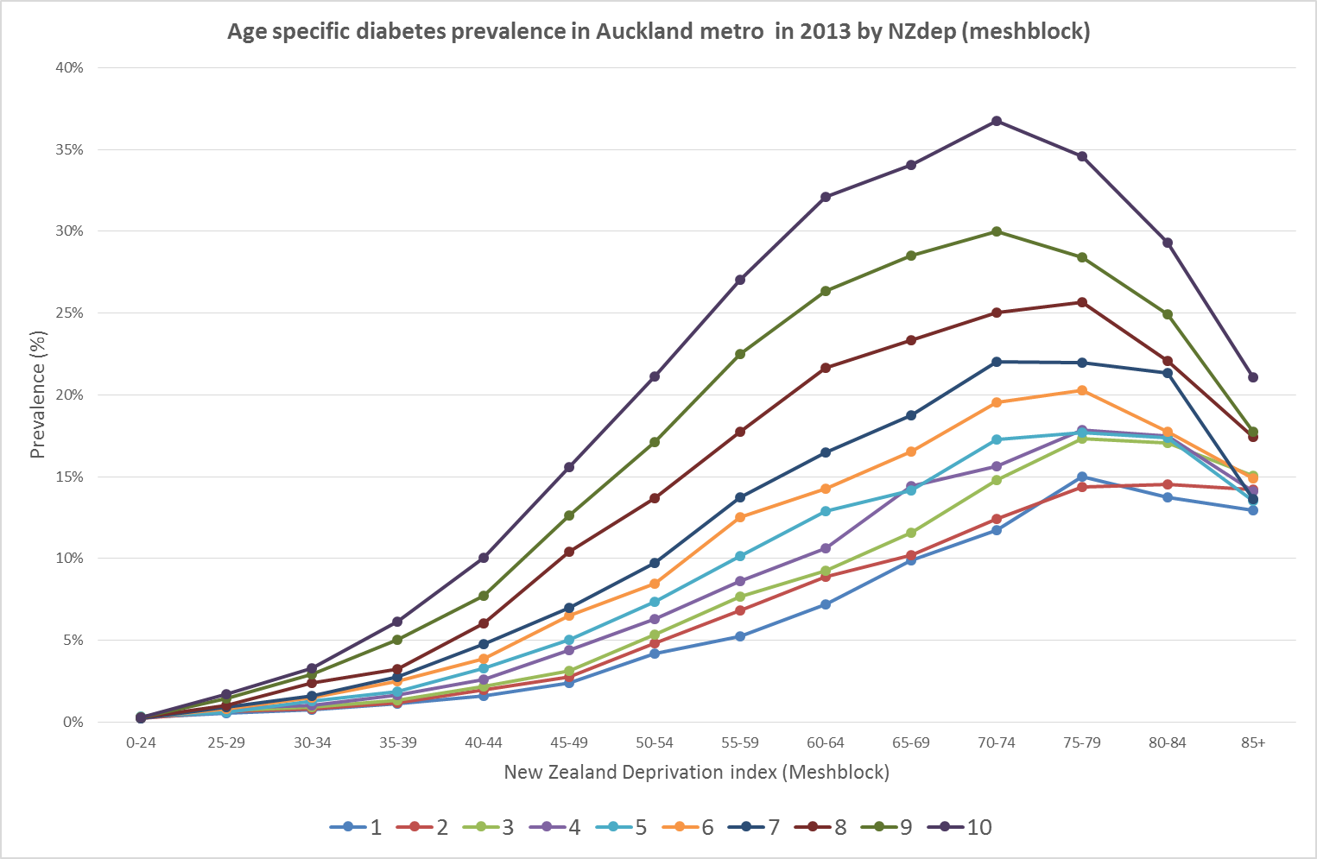
Age specific diabetes prevalence by NZDep

Slide 15
People with poor glucose control (HbA1c≥74.9) by age in 2013

Slide 16
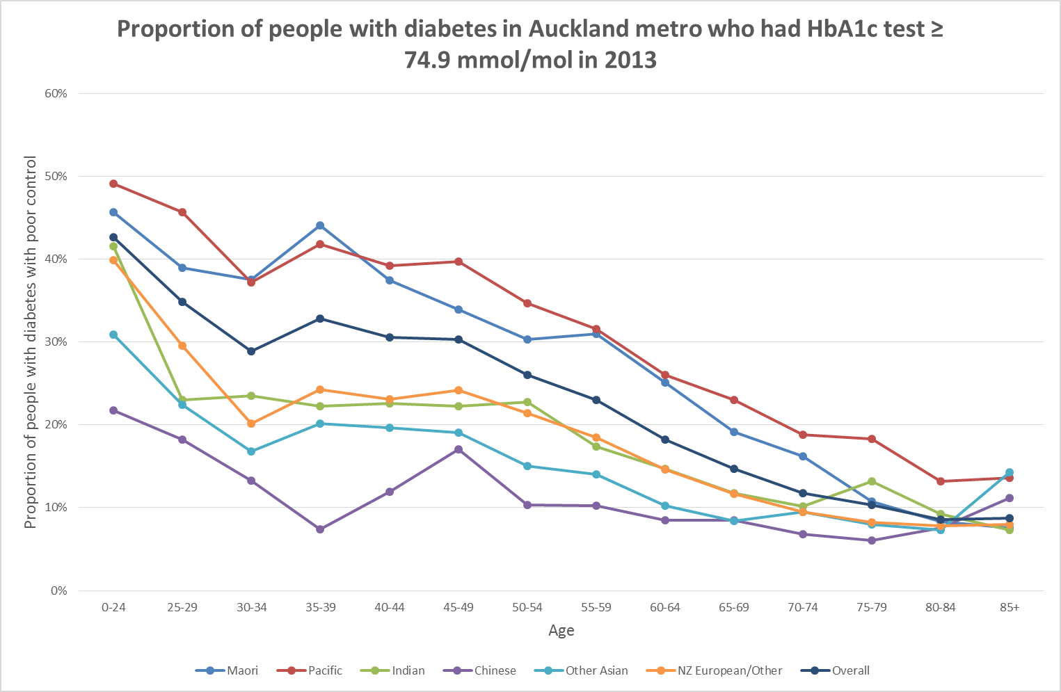
Proportion of people with diabetes who had poor glucose control in 2013 by ethnicity
Notes:
The level of control is highly associated with age (and to a lesser extent ethnicity)

Slide 17
Urinary albumin

Slide 18
Urinary albumin testing by ethnicity (one or more test)
Notes:
skip

Slide 19
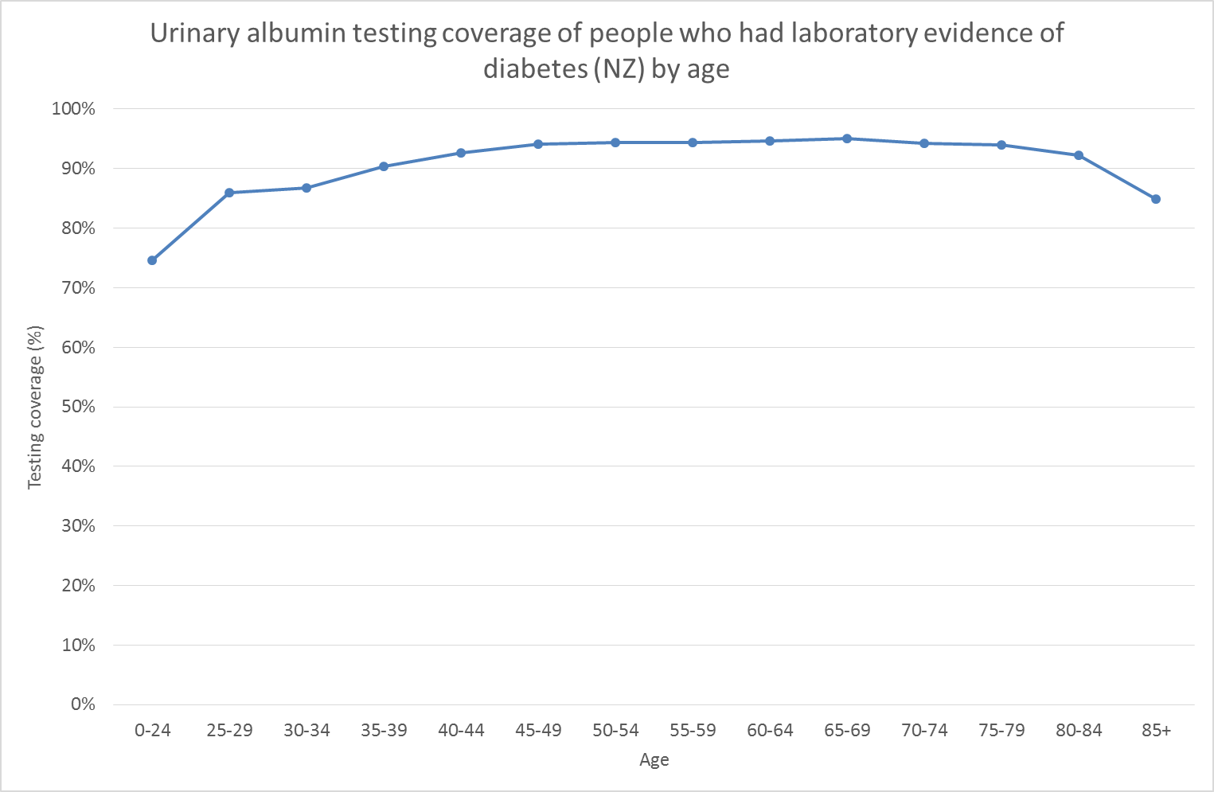
Urinary albumin testing by age (two or more test)
Notes:
skip

Slide 20
Prevalence of albuminuria/proteinuria within the group of people with laboratory evidence of diabetes
Denominator: number of people with laboratory evidence of diabetes within the health service utilisation population in 2013
Numerator: number of people with 2 or more positive tests of urinary albumin/protein in two different days
Notes:
skip

Slide 21
% of people with diabetes who had proteinuria in 2013
Notes:
Consistent demonstration of clinical need, where health utilisation may not necessarily be high, unmet needs.
Ranged from 31% to 59%.. Correlated with people with diabetes with poor control.

Slide 22
Albuminuria is age dependent

Slide 23
Defining Possible treatment gaps

Slide 24
ACE inhibitor and AIIRB use in people with diabetes and albuminuria/ proteinuria in CMDHB
Notes:
The definition of the indicator matters

Slide 25
Chronic kidney disease

Slide 26
Chronic kidney failure classification
GFR stages | GFR (mL/min/1.73 m²) | Terms
G1 | >90 | Normal or high
G2 | 60 to 89 | Mildly decreased
G3a | 45 to 59 | Mildly to moderately decreased
G3b | 30 to 44 | Moderately to severely decreased
G4 | 15 to 29 | Severely decreased
G5 | <15 | Kidney failure (add D if treated by dialysis)
Notes:
The analyses here only examined one creatinine test not two..

Slide 27
Estimated prevalence by eGFR status (within the subgroup of people without diabetes in 2013)

Slide 28
Estimated prevalence by eGFR status, (within the subgroup of people with diabetes in 2013)

Slide 29
Practice level breakdown

Slide 30
Purpose of practice level data
Describes the clinical context that we work in,
Explores practice variations, sharing helpful practice tips or model of care between practices that are helpful for our population,
Highlights specific clinical scenarios and where there may be opportunities for improvement,
Not about making judgement on quality

Slide 31
Patients that we look after
About 9,100 people with diabetes are enrolled in the 11 practices participating in the modified DCIP program. The proportion of people with diabetes that had poor glycaemic control ranges from 21% to 39% (average 31%). The proportion of people with diabetes, and had microalbuminuria ranges from 43% to 69% (average 61%)
Burden of disease is different by practices

Slide 32
Local data from TestSafe
Practice name | Number of people with diabetes | Number of people with HbA1c ≥74.9mmol/mol between Oct14 to Sep 15 | Number of people with diabetes with 2x positive urinary microalbumin
1 | 879 | 343 | 616
2 | 2,321 | 732 | 1,389
3 | 1,117 | 300 | 637
4 | 669 | 143 | 291
5 | 370 | 102 | 233
6 | 1,014 | 375 | 656
7 | 361 | 110 | 247
8 | 239 | 72 | 140
9 | 643 | 186 | 443
10 | 1,045 | 335 | 640
11 | 447 | 150 | 274
Total | 9,105 | 2,848 | 5,566

Slide 33
A degree of renal impairment is common
Within the modified DCIP practices, 20% of people with diabetes have eGFR <60mlmL/min/1.73 m2) , and 60% of people with diabetes do not have perfect kidney function
Implications for medication use

Slide 34
Number of people by stages of eGFR
Practice name | G1 Normal or high | G2 Mildly decreased | G3a Mildly to moderately decreased | G3b Moderately to severely decrease | G4 Severely decreased | G5 Kidney failure
1 | 245 | 399 | 125 | 61 | 29 | 27
2 | 1,034 | 867 | 229 | 106 | 47 | 50
3 | 364 | 519 | 114 | 65 | 24 | 30
4 | 274 | 271 | 71 | 31 | 15 | 9
5 | 161 | 140 | 41 | 14 | 6 | 10
6 | 347 | 444 | 113 | 61 | 29 | 24
7 | 129 | 148 | 43 | 17 | 11 | 13
8 | 115 | 76 | 23 | 14 | 6 | 8
9 | 212 | 274 | 85 | 39 | 20 | 17
10 | 473 | 374 | 99 | 47 | 31 | 25
11 | 198 | 160 | 52 | 13 | 10 | 16
Total | 3,552 | 3,672 | 995 | 468 | 228 | 229

Slide 35
Do people with poor glycaemic control attend GP practices?
Data via linkage to PHO enrolment
Yes, but the nature of the appointment may not necessarily be related to diabetes though
About 98% of people with HbA1c ≥74.9mmol/mol attended practice at least one in a year, and 83% had attended GP at least 3 quarters of the year.
Potential for opportunistic proactive care, or arranged dedicated appointments

Slide 36
Proportion of people with poor diabetes control attended GP practice
Practice Name | Attended at least once in a year | Attended at least 3 quarters of a year
1 | 97% | 81%
2 | 99% | 82%
3 | 97% | 83%
4 | 99% | 80%
5 | 99% | 87%
6 | 97% | 87%
7 | 98% | 93%
8 | 100% | 90%
9 | 100% | 87%
10 | 98% | 77%
11 | 100% | 89%
Total | 98% | 83%

Slide 37
Of those people with high HbA1c ≥ 74.9mmol/mol ..
80% of them were in oral hypoglycaemia meds (in a 6 month period)
48% were on insulin (in a 6 month period)
Only 10% were not on meds in the 6 month period.
Dose titration of meds (and type of medications) may be a useful focus of future learning session.
HbA1c from Oct 2014 to Sep 2015 (TestSafe), meds 2015 Sep to March 2016 from Pharmac Pharmhouse dispensing claims data

Slide 38
Use of meds for people with HbA1c ≥ 74.9 in a 6 month period
Practice name | Any meds | Insulin | Oral meds | Metformin | Acarbose | Pioglitazone | Sulfonylurea
1 | 89% | 40% | 81% | 75% | 29% | 0.0% | 50%
2 | 91% | 46% | 85% | 83% | 11% | 0.1% | 55%
3 | 92% | 53% | 81% | 78% | 15% | 0.0% | 59%
4 | 90% | 52% | 78% | 73% | 20% | 0.7% | 53%
5 | 94% | 67% | 79% | 74% | 4% | 3.9% | 44%
6 | 90% | 51% | 79% | 75% | 5% | 2.1% | 45%
7 | 89% | 51% | 77% | 75% | 5% | 0.0% | 46%
8 | 85% | 58% | 69% | 67% | 3% | 1.4% | 44%
9 | 90% | 51% | 79% | 76% | 13% | 0.0% | 59%
10 | 88% | 48% | 76% | 72% | 10% | 1.2% | 49%
11 | 88% | 51% | 78% | 75% | 12% | 0.0% | 53%
Total | 90% | 49% | 80% | 77% | 13% | 0.7% | 52%

Slide 39
What about treatment of microalbuminuria?
About 5,560 people with diabetes with 2 more positive urinary microalbuminuria enrolled in the 11 modified DCIP practices.
Overall 74% of them had received at least one script of Ace inhibitor or angiotensin II receptor blocker in a subsequent 6 months, but “adherence” appeared to fall over time and there were modest variations by practices.

Slide 40
What about treatment of microalbuminuria?
Practice name | Number of people with diabetes with 2x positive urinary micro albumin | One or more script in 6 months (ACEi or ARIIB) | 2 or more scripts in 6 months (ACEi or ARIIB)
1 | 616 | 72% | 65%
2 | 1,389 | 76% | 69%
3 | 637 | 76% | 67%
4 | 291 | 76% | 67%
5 | 233 | 67% | 63%
6 | 656 | 72% | 63%
7 | 247 | 72% | 64%
8 | 140 | 76% | 69%
9 | 443 | 76% | 70%
10 | 640 | 72% | 61%
11 | 274 | 68% | 59%
Total | 5,566 | 74% | 66%

Slide 41
In the subgroup with HbA1c ≥74.9mmol/mol and 2x positive microalbuminuria
Higher proportions of people with HbA1c ≥74.9mmol/mol had microalbuminuria (75%) compared to the general diabetes group (61%)
This group is at high risk for renal (and CVD) complications

Slide 42
In the subgroup with HbA1c ≥74.9mmol/mol and 2x positive microalbuminuria
Practice name | HbA1c ≥ 74.9 with 2x positive microalbuminuria | One or more script in 6 months | 2 or more scripts in 6 months
1 | 277 | 77% | 71%
2 | 527 | 82% | 74%
3 | 218 | 78% | 69%
4 | 87 | 75% | 64%
5 | 84 | 67% | 62%
6 | 294 | 76% | 68%
7 | 88 | 75% | 64%
8 | 56 | 79% | 71%
9 | 154 | 79% | 71%
10 | 243 | 76% | 57%
11 | 114 | 72% | 59%
Total | 2,142 | 77% | 68%

