Slide 1

“Modified” DCIP
Brandon Orr-Walker
July 2016

Slide 2

Outline
Basic Premises and Assumptions
Identifying the Opportunities
Efforts to date
What is DCIP all about?
Quality improvement in Diabetes Care
On focusing on helping mange diabetes in this group think about:
  “What would it take?”
  “How can we help?”

Slide 3
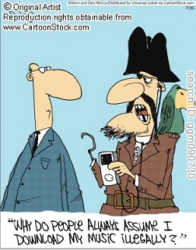
Basic Premises and Assumptions
Only worth making the diagnosis if we are going to change the progression of disease
Strong evidence base to reduce harm:
  Glycaemia
  BP
  Renal protection
  CVD risk
  Multifactorial management
Early good control pays long term dividends
We have people with diabetes at high risk of complications, and disparities exist
Since 2003 majority of care for people with T2DM is to be in primary care
Expertise in management is required to manage therapeutic challenge

Slide 4
Basic Premises and Assumptions
Not all of Primary care work is to do with Diabetes
  Not all of secondary care is either
There are parts of diabetes management done by primary care teams that don’t require any involvement of secondary care
  There are parts of diabetes management in secondary care not part of integration
The biggest opportunity for people with T2DM and poor control
despite our current efforts is in integrated care,
and
As poor control is mainly affecting Maori, Pacific and High deprivation groups, those efforts we will be equity focused.

Slide 5
Basic Premises and Assumptions
Currently in CMDHB:
Approximately 40,000 patients with diabetes
25% of patients with diabetes have HBA1c >= 75 mmol/mol
  8316 patients (CPHAC minutes 20/01/16)
  (nationally 28% >= 64, Australia 22% >= 64)
  Growing faster than the denominator (10% over 2 years)
  Less than ½ as likely to be referred /seen in secondary care diabetes clinics than ADHB/WDHB (only 14%)

Slide 6

Identifying the
Opportunities
The only thing we really know is what we are doing isn’t working well enough
  We need to be comfortable acknowledging that
  We need to keep our purpose of improving patient care in mind
We need to know what efforts we have made to date and understand what has worked well and what has not if we are going to design the best approach to achieve the best for our patients.

Slide 7
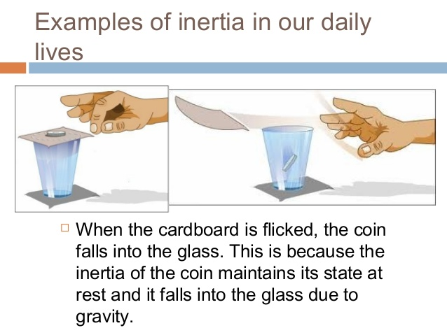
Treatment Inertia= clinical inertia
Two components:
Clinician inertia
Patient inertia
  Lack of access
  Health literacy
  Non-adherence
  Competing interests
  Refusal of treatment
    Uninformed/misinformed
    Well informed
  Many of the “patient inertia” factors can be clinician modified, and as healthcare professionals it is our role to do so to the best of our ability.

Slide 8

Identifying the Opportunities
For this integration work there are 4 Key Sources of Learnings:
Existing/recent approaches for diabetes care in primary care (AGC, CCM)
Reflection on our integration efforts to date with several practices since 2000 (Gill)
Clinical Quality opportunities identified from the literature,
Opportunities inherent in the design of DCIP, (and IMO largely untapped to date)

Slide 9
This Diabetes Implementation plan (2000)
was very aspirational
“The proposed changes include the establishment of local diabetes teams and
information systems to identify and monitor the needs within the regions.
Services to individuals with diabetes will also be improved with the introduction free annual reviews, increased education and management, reduced barriers to access, and
increased numbers of eye-screening examinations.”
“These changes focus on the removing the inequity of health outcome for Maori and
Pacific Island people, and include specific funding for new initiatives managed by
Maori and Pacific Island people.”
“New Zealand must establish a world-class comprehensive service for people with
diabetes. It must include prevention, early detection, and effective treatment at every
stage of the development of this disease.”
“We cannot afford to fail.”

Slide 10
Efforts to date: Annual Get Checked, CCM, DCIP
Annual Get Checked
Followed the NZ Health Strategy 2000, which identified a small number of health priorities and need for equity (for Maori and Pacifica)
“Diabetes 2000” informed also by the 1997 Ministry of Health document “Strategies for the Prevention and Control of Diabetes in New Zealand”.
  Allocated ½ of the initial $10M/yr budget.
  National Diabetes Working Group established
  Need to establish evidence based guidelines (via NZGG eg 2003)
  Local Diabetes Teams established, health targets etc
“Then we decided we would make the new PHOs accountable for actively managing quality of care delivered by their practices. We would not directly fund practices. But there were far too many PHOs” Sandy Dawson
By 2005 we were head of what was being achieved by the good US HMOs like Kaiser Permanente, and better than the UK.
By 2012 the Minister of Health believed that incremental care improvement wasn’t occuring

Slide 11
CCM: Big Effort, Big Investment
Designed as an integration project, guideline based manual, IT support, regular reporting and a major investment for proactive care and practice level enablement of nurses to become disease state managers
Resourced:
516,000 free GP visits (in addition to free AGC)
1.2 million practice nurse hours (1 million hours face to face delivery),
  equating to over 600FTE years practice nurse
  Including more than 70 FTE for 4 years of the program.

Slide 12
CCM: Big Effort, Big Data

Slide 13
Diabetes Care Improvement Packages
Attempt to provide flexibility to deal with local diabetes priorities
Traded “one patient- one free visit” for pooled resource (@DHB level) to be used to achieve unmet need with equity focus, and clinical governance.
It required and had buy-in from Diabetes NZ to achieve that.
Had to be patient care focused, patient facing and the expectation was that most (not necessarily all) would be delivered in primary care
It would be monitored, and investment refocused based on results in an annual planning cycle (quality improvement)
It explicitly aimed to reestablish clinical governance which had been faultering/absent.(Local Diabetes Team or equivalent)

Slide 14
Diabetes Care Improvement Packages: Implementation in CMDHB
Approach was to:
  reward primary care for any downward change of HBA1c, (regardless of the reason for it), and/or reward practices for maintaining levels below a threshold.
  Provide funding for some allied health services.
The former was “passive” and required sharing of NHI based clinical data (HBA1c) between the practices/PHO and the DHB for the reward to be calculated and distributed to practices. It replaces a patient’s entitlement for a free annual check with incentive payments for primary care.
The latter required explicit “action” to refer to third parties. It is undoubtedly patient-facing and provides services for patients when deemed appropriate by the GP. It has been undersubscribed.

Slide 15

Evidence base of Quality Improvement in Diabetes Care Management
3 key points from Literature:
Integration
Its about action not process alone
Some strategies work, some don’t
  as best illustrated by largest meta-analysis
    162 trials of 5592 from search strategy

Slide 16
*

Slide 17
*

Slide 18
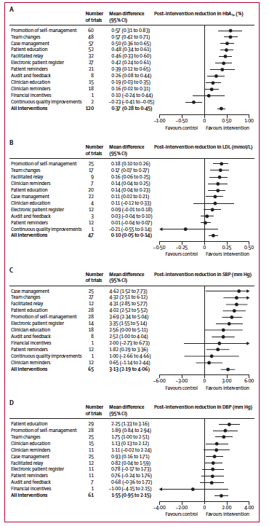

Quality Improvement Strategies
Tricco et al , The Lancet 2012 June 9

Slide 19
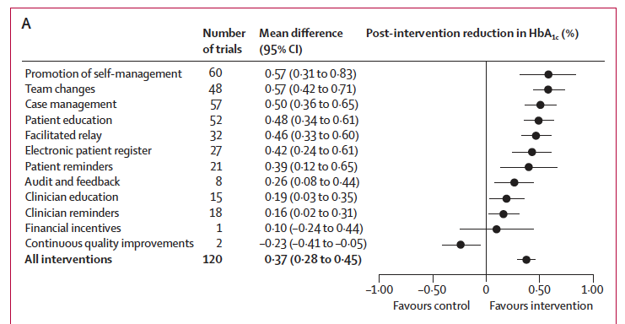
Quality Improvement Strategies
Tricco et al , The Lancet 2012 June 9

Slide 20
Key factors to success
Acknowledge that as doctors we are not automatically expert/well positioned at diabetes management and “coaching”
Identify what isn’t working and where the gaps are
Knowledge of evidence
Champions for care improvement and where required change.
Culture of improvement not “process” led
Identify a grass roots strategy (“what we need to achieve the outcome”)
Develop and support expertise eg DNS
Have a strong clinician voice articulating/demanding the above (not DHBs and PHOs, they are the support)
  GP voice
  Clinical Governance processes
Disregard the unhelpful/unsuccessful to free resource for successful.
An intensity and follow-up to ensure achievement of results (drive success, cQI cycles)
Any “plans” need to be patient facing/focused not provider focused/rewarding as their design priority.

Slide 21
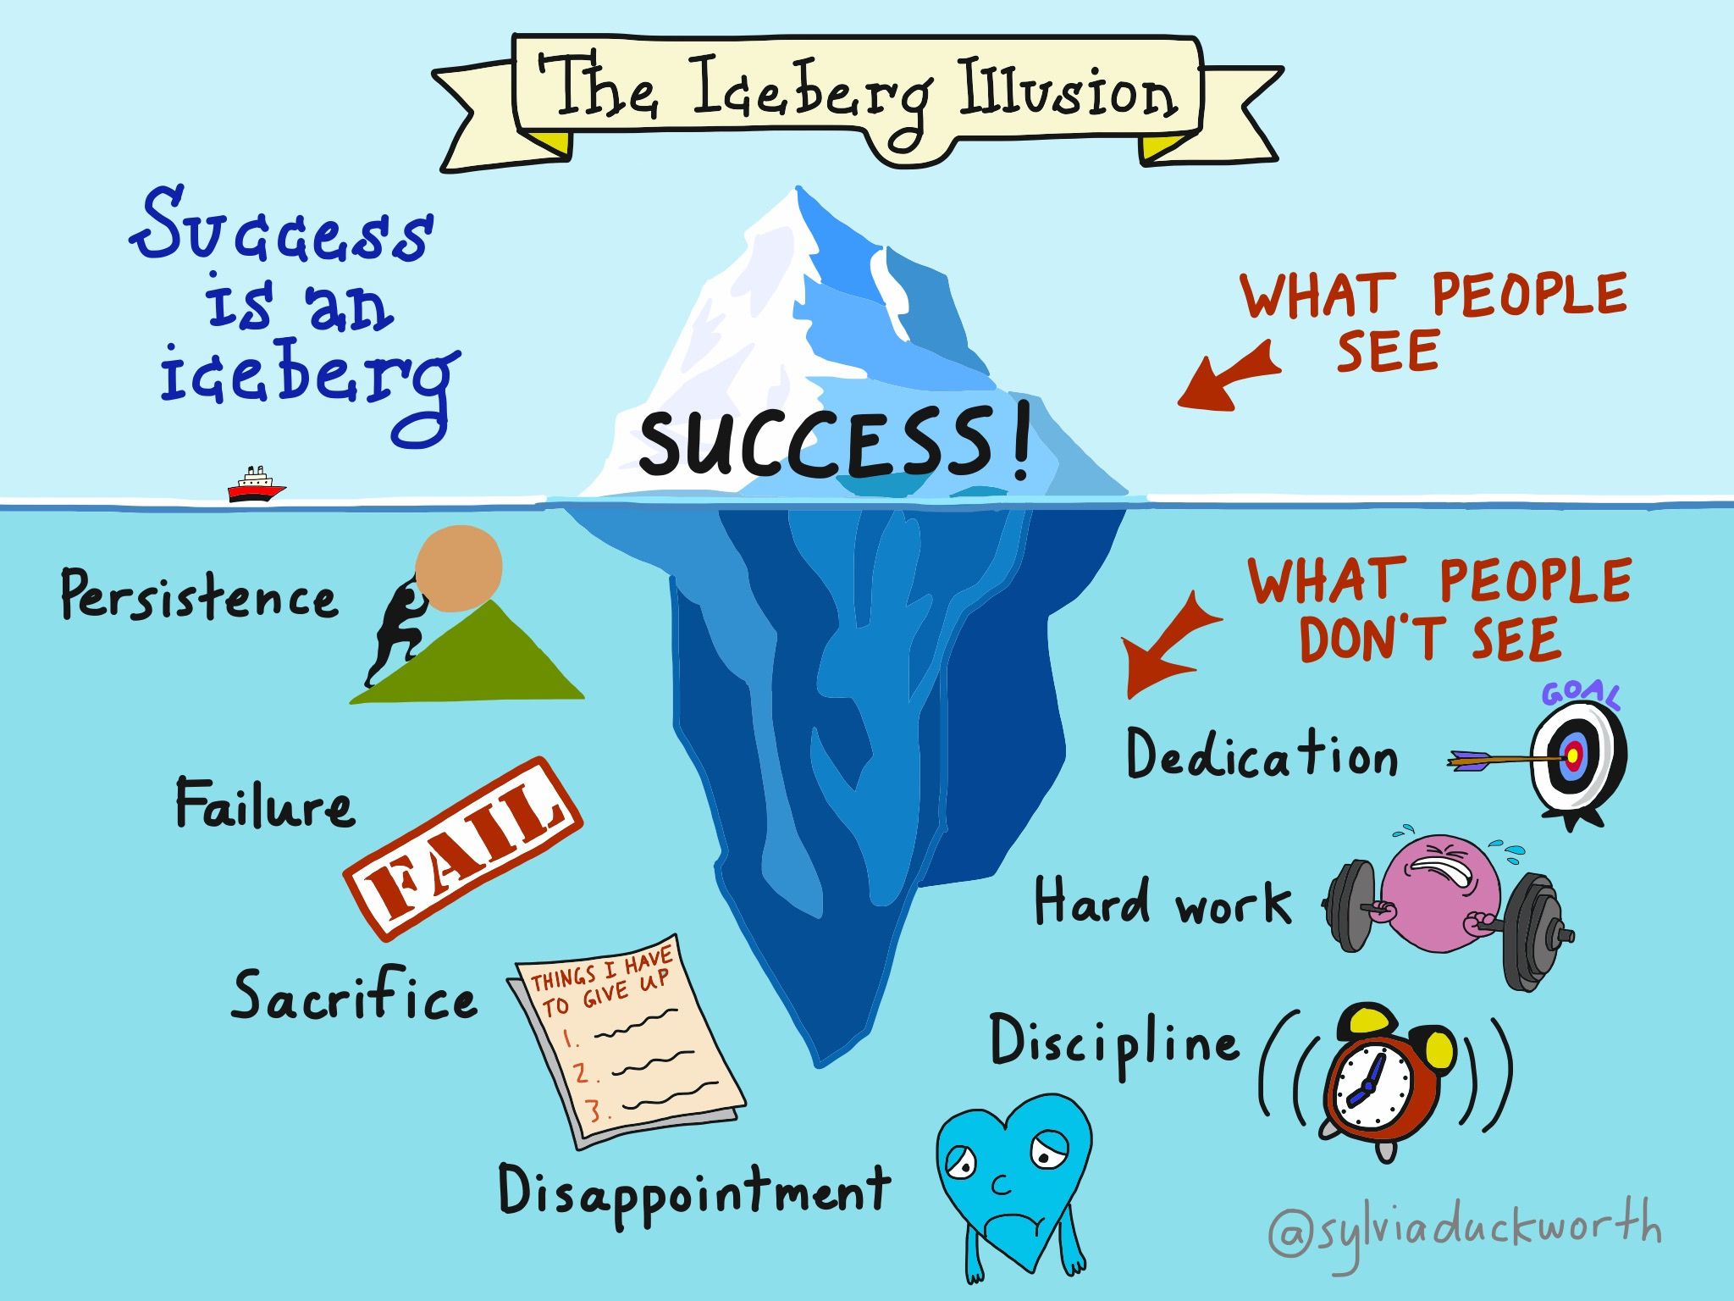

Slide 22

What would it take?
Thinking of your practice/practice population what factor or factors do you think could be enhanced to improve diabetes management (in the broadest terms ie adherence, lifestyle and medical therapies, management of complications eg foot problems)?
Improved care of people with poor glycaemic control (>=75mmol/mol) has been identified as a priority group to reduce progression to renal failure and associated complications of which they are at high risk. Thinking about patients who are in this group, what factor or factors do you think could be enhanced to improve their care?

Slide 23
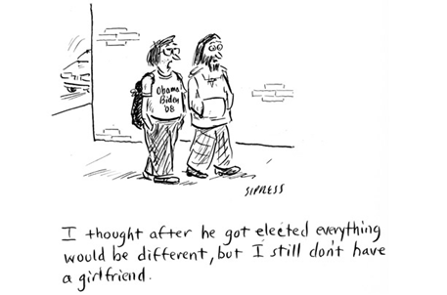
So its all sorted…?

Slide 24
Suggestions from a small group of GPs (pers com Dr Tim Hou)
Remove cost barriers for patients to pick up medications
Simplify referral process so people can remember easily
Too many criteria apply before you can refer to ....
Upskill our nurses so they can provide 24/7 dietetics, education & foot care, insulin starts.
24/7 care important as need to get patients when they're here rather than when professionals are here - the warm hand over.
Also inhouse care better c/- team env/culture & quality & accountability
Question? Does it need to be a nurse
How do we free up time for them to do this work
"Probably more nursing hours and training, nothing you haven't already covered.”
"For the number of patients we have with diabetes, I would like
- A diabetes nurse specialist in our clinic every day of the week (for a few hours)
- A diabetes specialist clinic in our clinic, either seeing patients or doing virtual reviews, every week, until no patients with hba1c>80 (number chosen with no evidence base)
- An app for those patients with smart phones – care plan, goals, hba1c, bp, reminders when next test due, lab form on app they can present to labtest
- GP 1 hour consult free for patient once a year
- Self management group education run in our clinic by our nurses every week. Patients more likely to attend something run by us than referral to another service
- “fast-track” for patients with good control, so we can reward those who have all parameters under control, only see them once a year. This is an internal issue, i.e. we can do it, if I could persuade my colleagues, and we had good monitoring “
“Assist us establish a ‘better community diabetes care program with appropriate resourcing and support’
This could be run by nurses-Practice nurses and Community Health Educators and the resource to manage patients devolved from secondary Care to the GPs and nurses under whom the patients are registered.
We know that the majority of T2DM patients are uncomplicated and these could be managed by our Practice Nurses.
The more complex ones should be seen by GPs with Specialist assistance/input. These could be funded along ARI Complex cases with some input to addressing social issues
We should have a register(IT) of all T2DM so that the diabetics can be tracked in the community as well as in second

